Slide 1



Accurate Prediction of Formylation PTM Site using Multiple Feature Fusion with LightGBM Resolving Data Imbalance Issue
Authors: S.M. Shovan$^{∗}$, Md. Al Mehedi Hasan$^{∗}$, Md. Rabiul Islam$^{∗}$
$^{∗}$Rajshahi University of Engineering & Technology
Presented By
S.M. Shovan

Slide 2
Outline
Post-translational modification (PTM)
Effects of PTM
Ways to identify PTMs
Background
Objective
Methodology
Dataset Selection
Feature Extraction
Feature Scaling
Feature Selection
Data Imbalance Issue
Classification
Measuring Matrices
Results
Conclusion
References

Slide 3
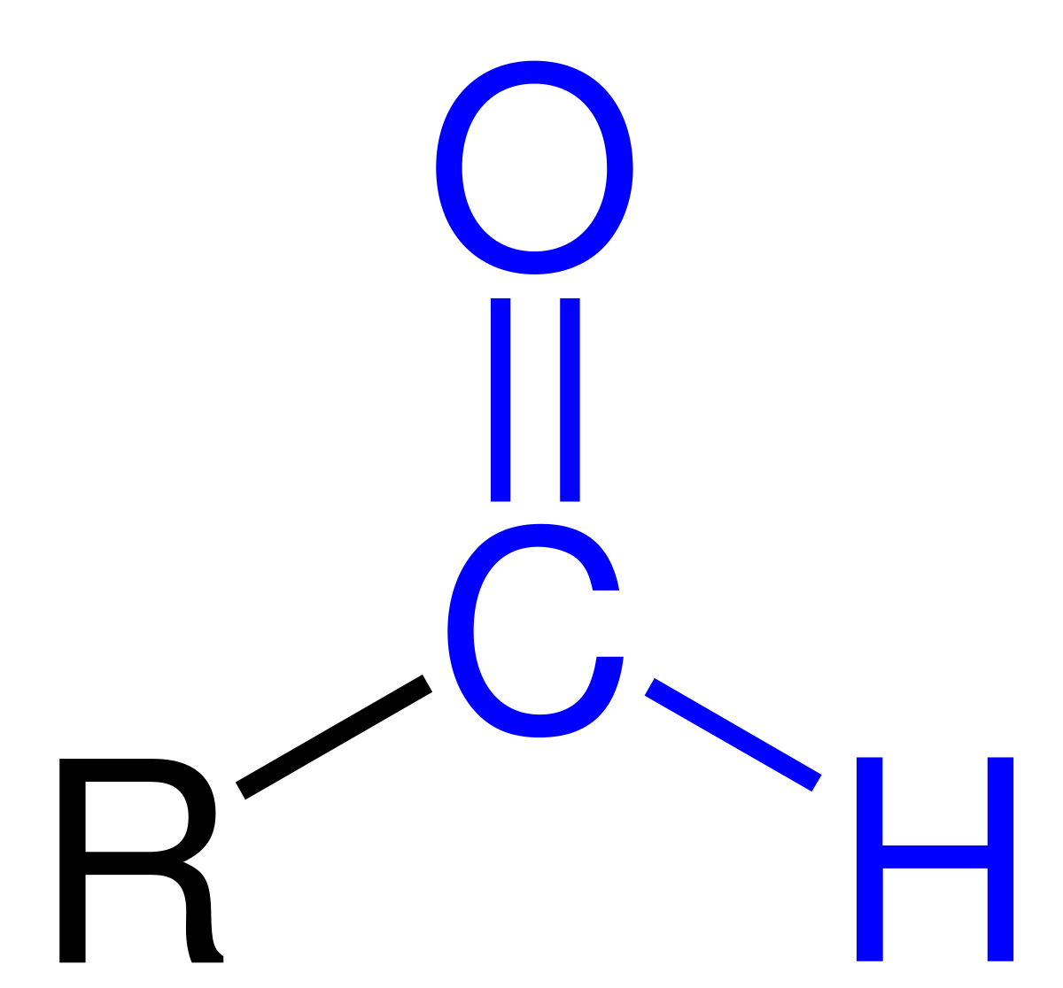
Post-translational Modification
Central dogma: The process of the formation of protein from DNA.
DNA
RNA
Protein
Transcription
Translation
Fig. 01: The Central Dogma of Molecular Biology
PTM is enzymatic modification of proteins following protein biosynthesis.
There are 20 standard amino acids : A, C, D, E, F, G, H, I, K, L, M, N, P, Q, R, S, T, V, W, Y
Lysine (K) PTM: Acetylation, Succinylation, Malonylation, Glycation, Methylation, Formylation etc[1-4].
The addition of a formyl functional group in the amino acid side chain is termed formylation[3].
A formyl functional group consists of a carbonyl bonded to hydrogen

Slide 4
Effects of PTM
Responsible for structural and functional diversities
Results in expansion of genetic code
Sometimes causes chronic diseases.
Formylation:
Affects DNA binding[4].
Plays a vast amount of role in the epigenetics of chromatin activities [5-6].
Damages the DNA by oxidating[7].
Causes hindrance of gene expression[7-8].
Results in chronic disease like cancer[8].
Necessary for:
Early detection or prediction of diseases
Drug development
Knowledge of fundamental functionality of proteins.

Slide 5
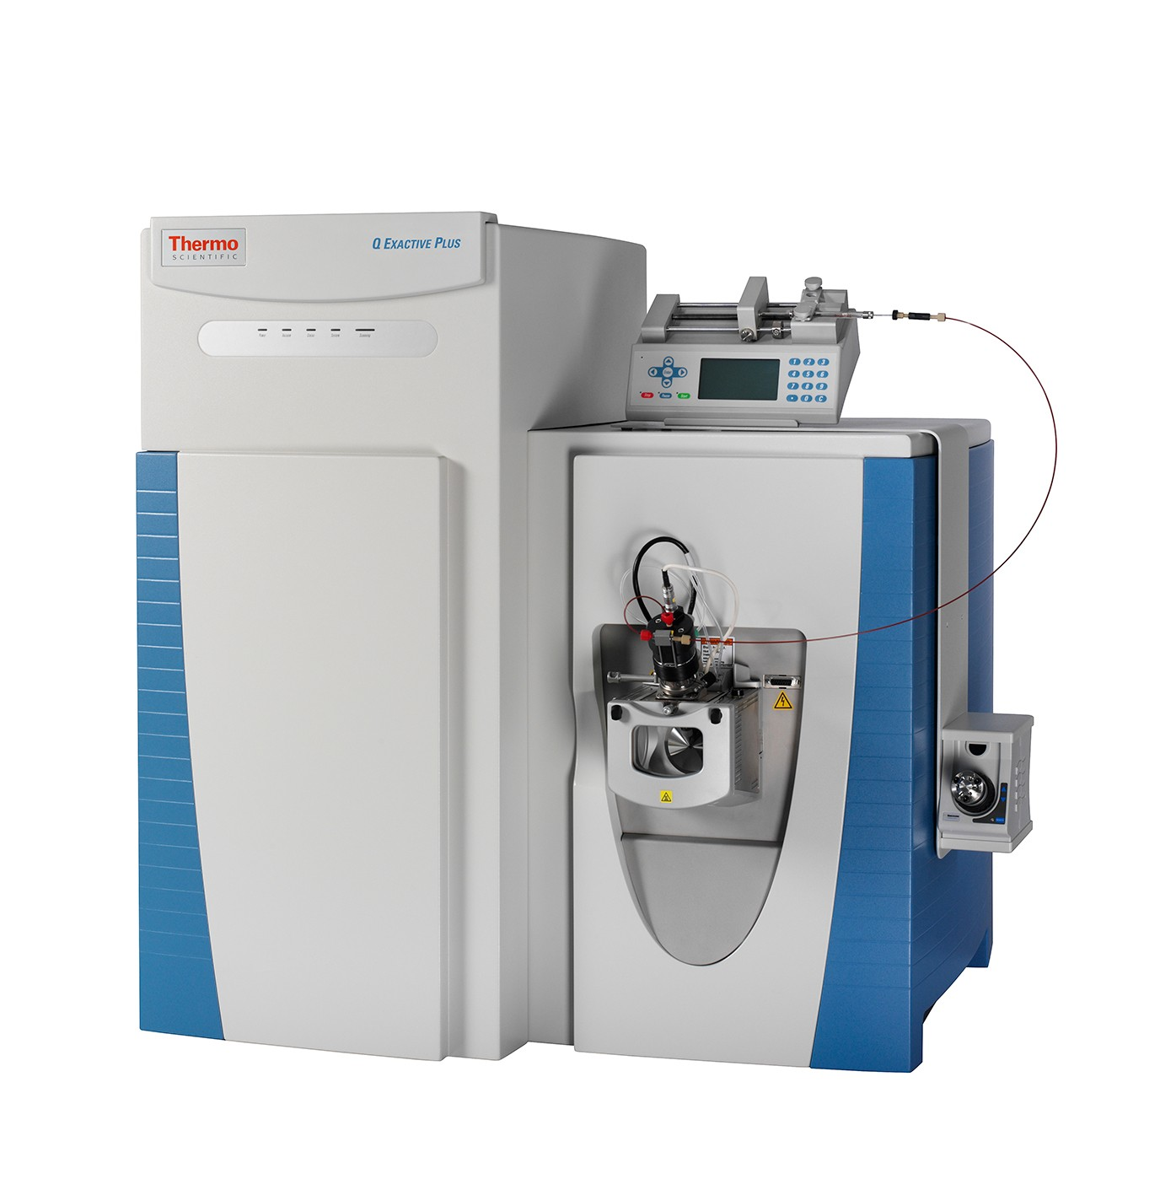

Ways to identify PTMs
Two approaches
Laboratory Approach
Mass spectrometry [9]
Requires Expertise
Expensive machines
Takes substantial amount of time
Computational tool
Effective Predictor
No expertise needed
Does not require expensive machines
Takes very less amount of time

Slide 6
Background
Prediction of lysine formylation sites using the composition of k-spaced amino acid pairs via chou’s 5-steps rule and general pseudo components
Authors: Z. Ju and S.-Y. Wang
Publisher: Genomics
Publication date: 2020
Dataset
PLMD
Feature extraction technique
K-Spaced Amino Acid Pairs (CKSAAP)
Classification Technique:
Biased Support Vector Machine

Slide 7
Objective
Development of more effective predictor for prediction of Formylation PTM site

Slide 8
Methodology
Dataset collection
Feature extraction
Data Balancing
Feature selection
Classification
Validation
Performance eval.

Slide 9
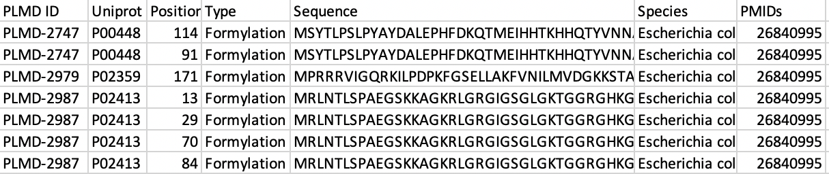
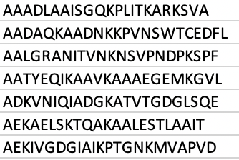
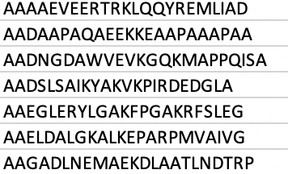
Dataset selection
Dataset Source: PLMD (Protein Lysine Modification Database) [10]
Proteins: 97
Positive sites: 188
CD-Hit: 40%
Window size: 23
Fig 02. Screenshot of a portion of dataset
Positives: 167
Negatives: 1431
Fig 03. Positives
Fig 04. Negatives

Slide 10
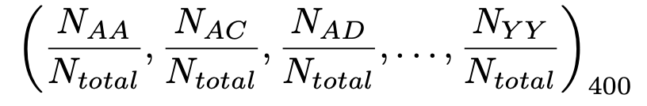
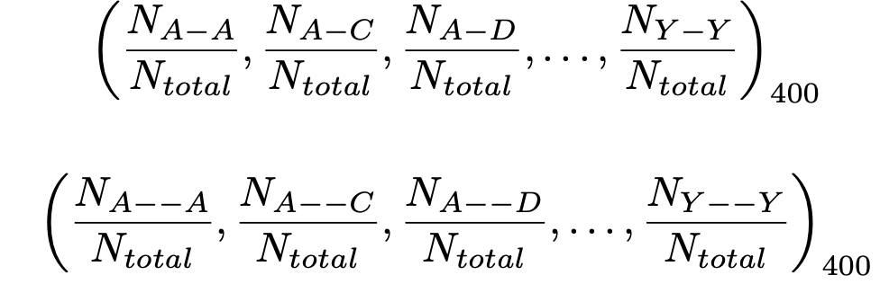
Feature Extraction
CKSAAP: Composition of K-Spaced Amino Acid Pairs [4]
Works by calculating frequency of the occurrence of amino acid pairs considering gaps in mind.
K= 5 generates 2400 length of feature vector

Slide 11
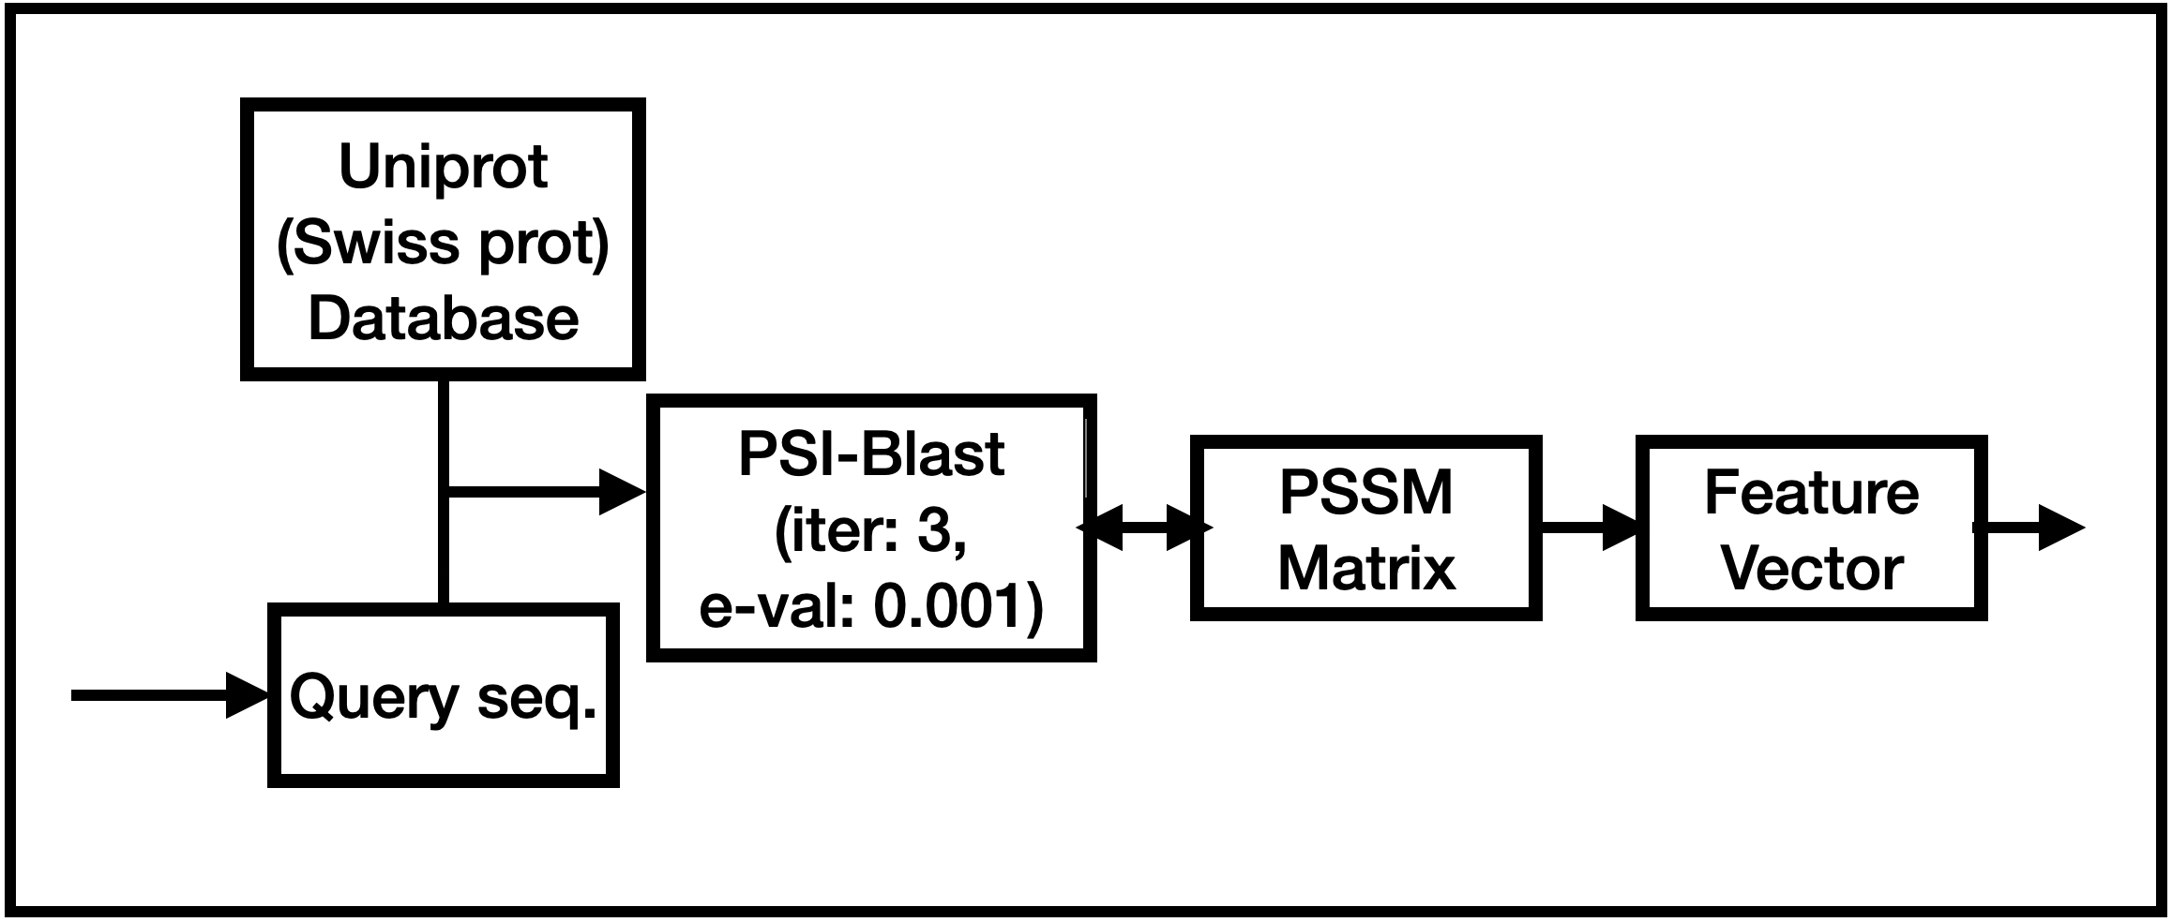
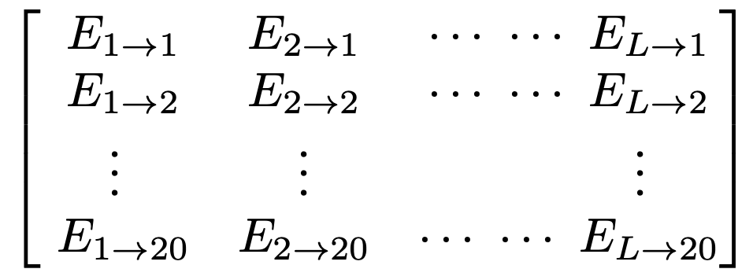
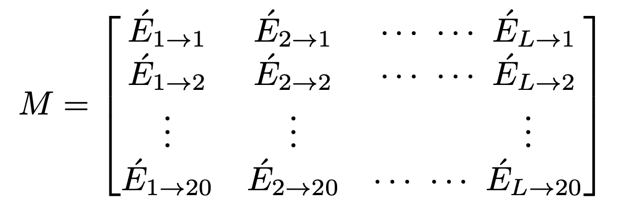
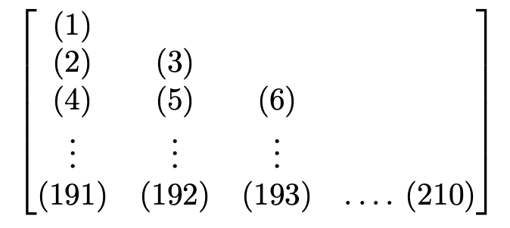


Feature Extraction
Evolutionary Features: Position specific scoring matrix using PSI-Blast [1]
Considers “mutation” evolutionary information.
Fig 5: Working principle of PSI-Blast
PSSM Matrix
Normalized PSSM Matrix
$$M^{T}M$$

Slide 12
Feature Extraction
Physicochemical Properties [11]
For instance, Hydrophobicity, Heat capacity, absolute entropy, mean polarity etc.
AAIndex Database contains 544 unique properties.
531 properties has no null value
Length of the vector for one amino acid: 531
Length of the feature vector: 23 ⨉ 531 = 12213

Slide 13
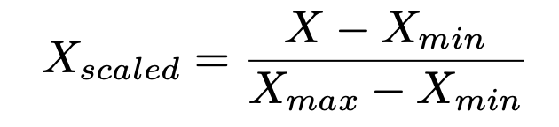

Feature Scaling
Minmax Scaler
Scaling rescales all the features into the range of 0 – 1 so that no dominant feature exist.
Here, $X_{max}$ is the highest value and $X_{min}$ is the lowest value of a specific feature.

Slide 14
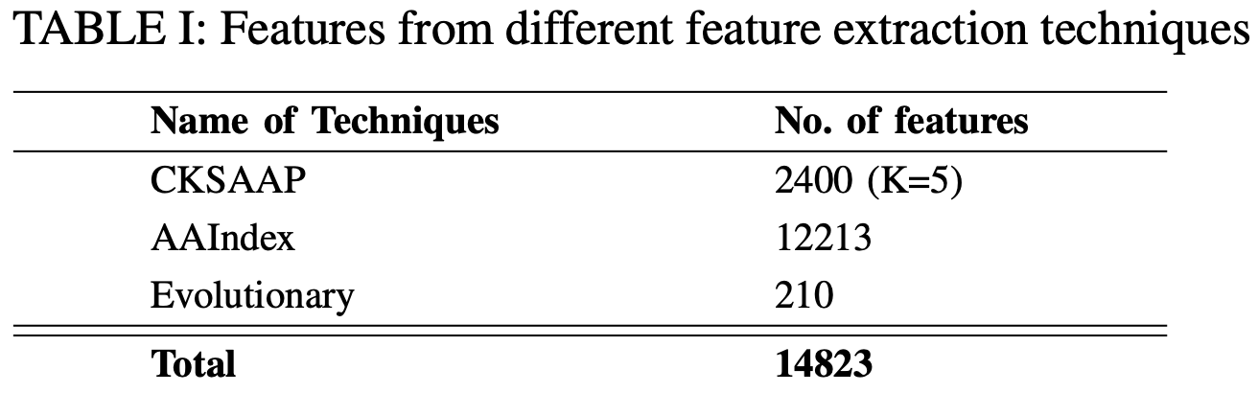
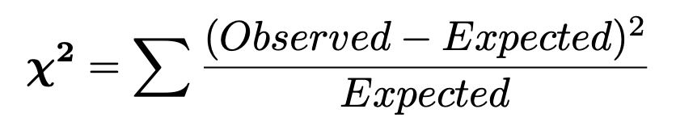
Feature Selection
Only considered best 500 features determined by the chi-square statistics.

Slide 15
Data Imbalance Issue
SMOTE
Smote is an oversampling technique that create synthetic data based on the minority class. [12]
Data is split for validation and independent test set with 60-40 ratio.
Positives: 167, Negatives = 1431, Total: 1598
60% of 1598 = 958 data points for validation
958 data points are balanced using SMOTE which gave us 1696 data points for model validation

Slide 16
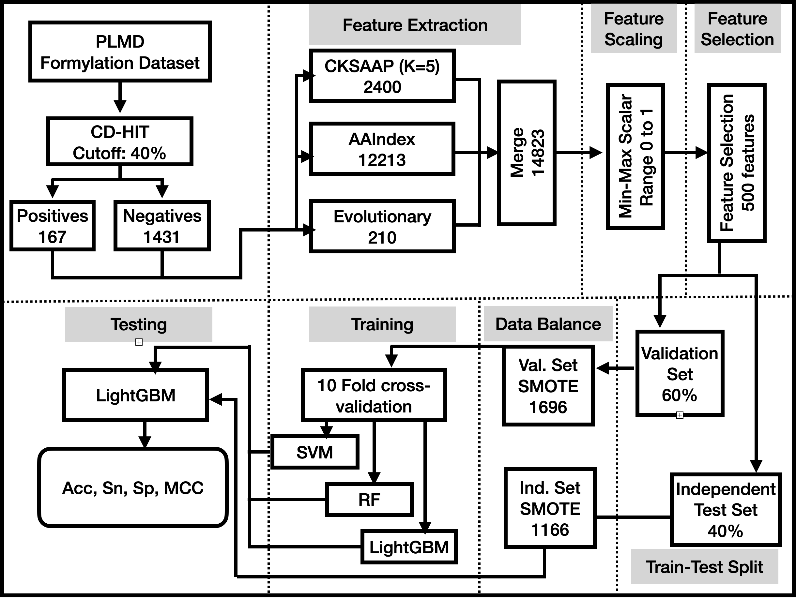
Model Flow Diagram
Fig 06: Summary diagram of the whole process.

Slide 17
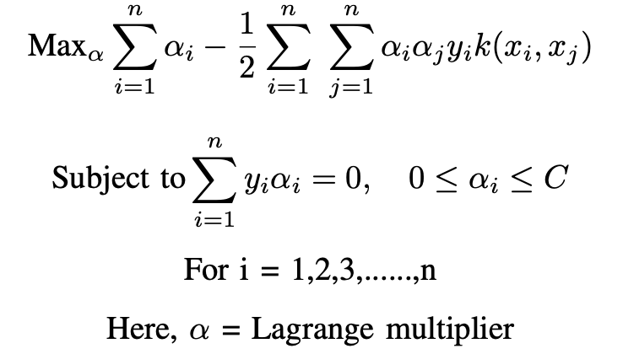
Classification
Support vector machine: Generates hyperplane to separate between classes. [13-14]
Random Forest: It is a decision tree- based ensemble classifier which creates multiple decision trees from the dataset and predict for each sample and the decision is taken based on the highest voting [15].
LightGBM: It is a gradient boosting classifier based on a decision tree. Each time the prediction is made by the weak learners, the misclassified data points re-adjust the loss function so that it minimizes [16-17].

Slide 18
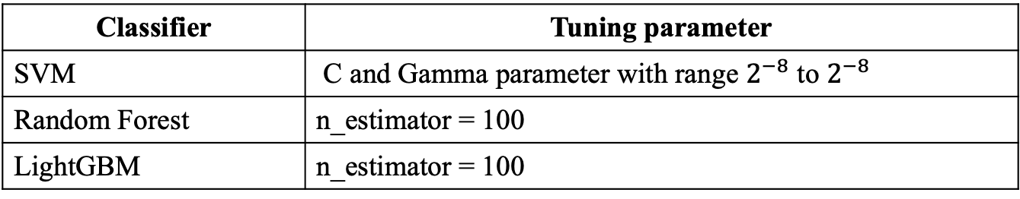
Classification
Classifier | Tuning parameter
SVM | C and Gamma parameter with range $2^{−8}$ to $2^{−8}$
Random Forest | n_estimator = 100
LightGBM | n_estimator = 100
Model validation:
10-fold cross validation

Slide 19
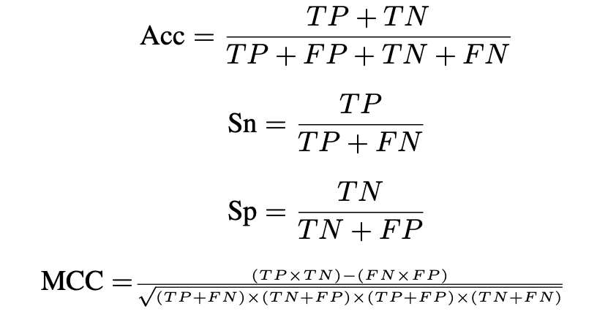
Measuring Matrices
Here, TP, FP, TN & FN stands for True Positive, False Positive, True Negative & False negative respectively having the conventional definition [18]

Slide 20
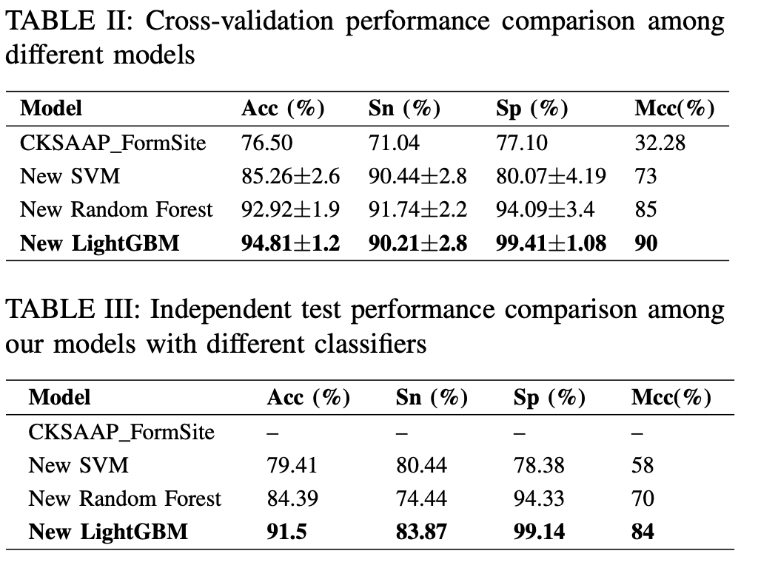
Results

Slide 21
Conclusion
Multi-feature fusion preserved information of different aspects that helps to separate the classes.
Choosing the best classifier also helped further improvement
Contribution
An effective high performance model that can predict the formylation PTM site accurately
Improvement Scope:
Non-redundant dataset usage might give better quality feature vector while running PSI-Blast
Other domain of feature extraction technique may give further improvement.
Deep network may further improvement in the classification phase.

Slide 22
References
[1] Y. Du, Z. Zhai, Y. Li, M. Lu, T. Cai, B. Zhou, L. Huang, T. Wei, and T. Li, “Prediction of protein lysine acylation by Integrating primary sequence information with multiple functional features,” Journal of proteome research, vol. 15, no. 12, pp. 4234–4244, 2016.
[2] Y. Zhang, R. Xie, J. Wang, A. Leier, T. T. Marquez-Lago, T. Akutsu, G. I. Webb, K.-C. Chou, and J. Song, “Computational analysis and pre- diction of lysine malonylation sites by exploiting informative features in an integrative machine-learning framework,” Briefings in bioinformatics, vol. 20, no. 6, pp. 2185–2199, 2019.
[3] Z. Ju and S.-Y. Wang, “Prediction of lysine formylation sites using the composition of k-spaced amino acid pairs via chou’s 5-steps rule and general pseudo components,” Genomics, vol. 112, no. 1, pp. 859–866, 2020.
[4] S. Shovan and M. A. M. Hasan, “Prediction of lysine glycation ptm site in protein using peptide sequence evolution based features,” in 2019 International Conference on Electrical, Computer and Communication Engineering (ECCE). IEEE, 2019, pp. 1–5.
[5] T. Wang, Q. Zhou, F. Li, Y. Yu, X. Yin, and J. Wang, “Genetic incorpo- ration of nε-formyllysine, a new histone post-translational modification,” ChemBioChem, vol. 16, no. 10, pp. 1440–1442, 2015.
[6] S. Lee, “Post-translational modification of proteins in toxicological research: focus on lysine acylation,” T oxicological research, vol. 29, no. 2, pp. 81–86, 2013.

Slide 23
References
[7] T. Jiang, X. Zhou, K. Taghizadeh, M. Dong, and P. C. Dedon, “N- formylation of lysine in histone proteins as a secondary modification arising from oxidative dna damage,” Proceedings of the National Academy of Sciences, vol. 104, no. 1, pp. 60–65, 2007.
[8] J. R. Wis ́niewski, A. Zougman, and M. Mann, “N ε-formylation of lysine is a widespread post-translational modification of nuclear proteins occurring at residues involved in regulation of chromatin function,” Nucleic acids research, vol. 36, no. 2, pp. 570–577, 2008.
[9] R. Aebersold and M. Mann, “Mass spectrometry-based proteomics,” Nature, vol. 422, no. 6928, pp. 198– 207, 2003.
[10] H. Xu, J. Zhou, S. Lin, W. Deng, Y. Zhang, and Y. Xue, “Plmd: An updated data resource of protein lysine modifications,” Journal of Genetics and Genomics, vol. 44, no. 5, pp. 243–250, 2017.
[11] S. Kawashima and M. Kanehisa, “Aaindex: amino acid index database,” Nucleic acids research, vol. 28, no. 1, pp. 374–374, 2000.
[12] N.V.Chawla,K.W.Bowyer,L.O.Hall,andW.P.Kegelmeyer,“Smote: synthetic minority over-sampling technique,” Journal of artificial intel- ligence research, vol. 16, pp. 321–357, 2002.
[13] K. Duan, S. S. Keerthi, and A. N. Poo, “Evaluation of simple per- formance measures for tuning svm hyperparameters,” Neurocomputing, vol. 51, pp. 41–59, 2003.
[14] T. S. Furey, N. Cristianini, N. Duffy, D. W. Bednarski, M. Schummer, and D. Haussler, “Support vector machine classification and validation of cancer tissue samples using microarray expression data,” Bioinformatics, vol. 16, no. 10, pp. 906–914, 2000.

Slide 24
References
[15] A. Liaw, M. Wiener et al., “Classification and regression by randomfor- est,” R news, vol. 2, no. 3, pp. 18–22, 2002.
[16] G. Ke, Q. Meng, T. Finley, T. Wang, W. Chen, W. Ma, Q. Ye, and T.- Y. Liu, “Lightgbm: A highly efficient gradient boosting decision tree,” in Advances in neural information processing systems, 2017, pp. 3146– 3154.
[17] Y. Liu, Z. Yu, C. Chen, Y. Han, and B. Yu, “Prediction of protein crotonylation sites through lightgbm classifier based on smote and elastic net,” Analytical Biochemistry, p. 113903, 2020.
[18] M. W. Ahmad, M. E. Arafat, S. Shovan, M. Uddin, O. F. Osama, and S. Shatabda, “Enhanced prediction of l ysine propionylation sites using bi-peptide evolutionary features resolving data imbalance.”

